Slide 1
PRESENTATION
REVIEW
Topic: Prototype
Hoàng Bảo Vy
Nguyễn Thị Cúc
Tống Thị Trâm
Trịnh Gia Hiển
Nguyễn Thu Hiền

Slide 2
Before we start
identify the Keywords
Write down some notes

Slide 3
Table of Contents
Protype?
2. Review
1. Summary
3. Question

Slide 4
01
Summary
Let’s Run it back

Slide 5
Concept
PROTOTYPE
- Early model
test
Concept
process
system analysts
Evaluate a new design
- Allow
by
enhance precision
users

Slide 6
Steps
PROTOTYPE
Low-fidelity
mid-fidelity
High-fidelity
Sketch
Wireframe
Mockup
PROTOTYPE

Slide 7
Wireframe
Mockup
PROTOTYPE
Sketch
Wireframe
The UI structre
Quick sketch
Detailer
Quick note the ideas
Show
Operation flow
Information structre

Slide 8
Tools
PROTOTYPE
Sketch
Wireframe
Mockup
PROTOTYPE
Paper
board
Balsamiq
AxureRP

Slide 9
Why prototype?
PROTOTYPE
Stakeholders
Easier for working for both sides
Discuss
Team members
Ideas
PROTOTYPE
Field test
Evaluation
Good decisions

Slide 10

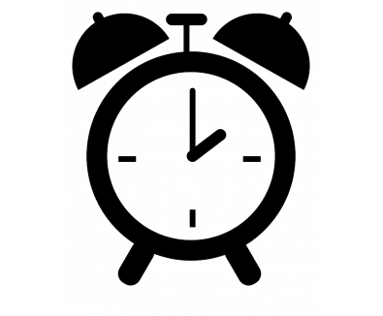
PROS
CONS
Detect errors
and
consuming
Flexible
Inconsistent
Better understanding
Misunderstood
Stakeholders
Team members
Stakeholders
Team members

Slide 11
02
Preceding Review
There are always room for improvement

Slide 12
oUTLOOK
Presentation
Throughly
Given information
Comprehensible
TOO
Specific

Slide 13
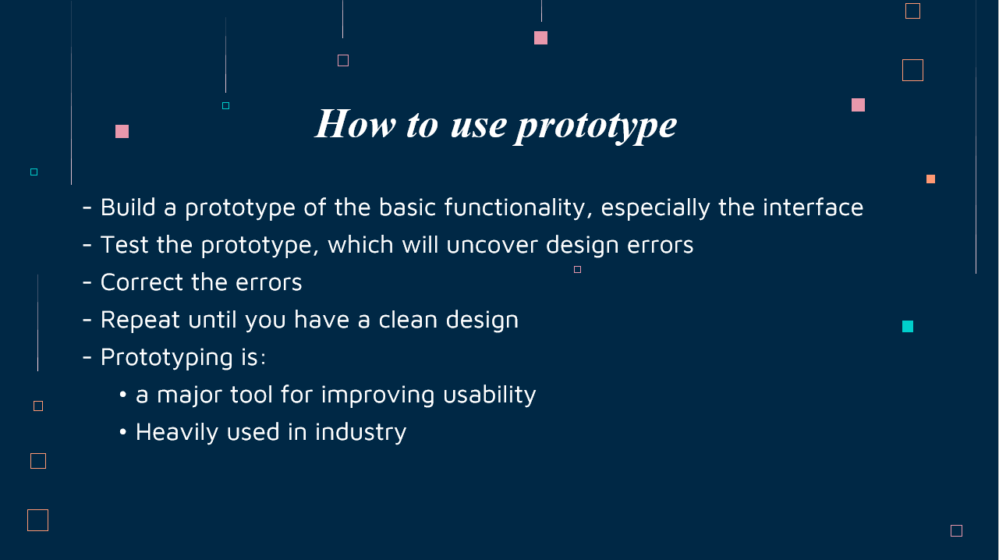
Content
Presentation
General
Misunderstood imparting
Steps to Build a Prototype

Slide 14
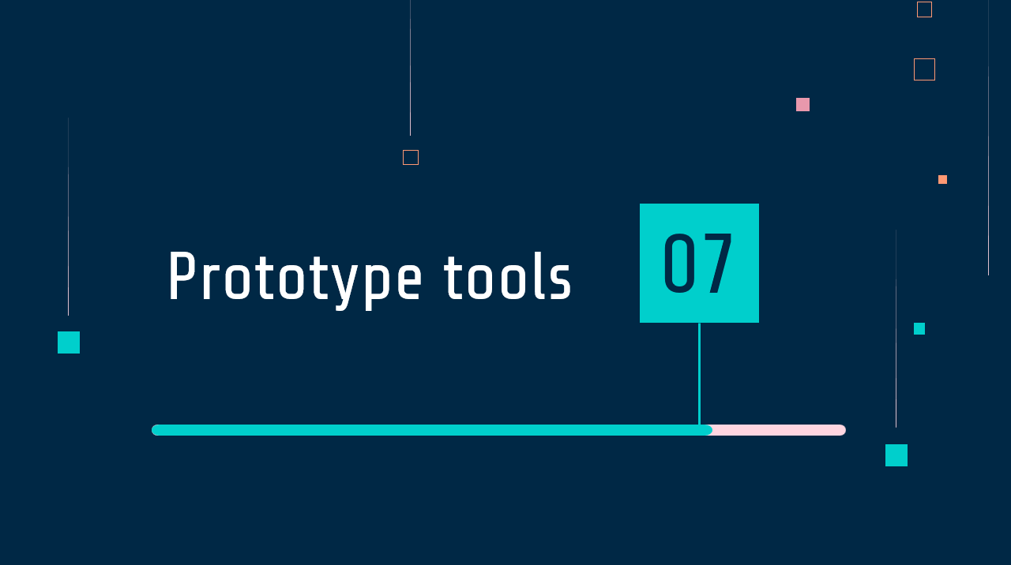
Content
Presentation
Misunderstood imparting
“Sketch” process was missing
Prototype Process

Slide 15
02.2
Throughout Review

Slide 16
03
Questions
Q&A time

Slide 17
In designing process, which step in wireframe, mock up, prototype belongs to ui designer, which step belongs to ux designer?
Prototype
“Tools”

Slide 18
Opinion: All wireframes are prototypes but not all prototypes are wireframes
Prototype
“Tools”
In what situation, prototype isn’t a wireframe? In addition, as a fact that Mockup is Wireframe itself, can mockup has the same above concept as wireframe?

Slide 19
Project
Treasury Management System
work on a website
Which type of prototype should we working on?
Prototype
Types

Slide 20
Pros and Cons
In what situation, we should use prototype in order to have it full potential?

